Slide 1
Resilience: Use various rules to determine atomic mass and structure
Atomic Structure
L/O – Deduce the structure of different elements
Last week: State how you would separate a mixture of a liquid and an insoluble solid
Last term: Identify the type of wave found in water
Last year: Calculate the actual size of the section of the onion cells
Key Words
Proton
Neutron
Election
Nucleus
Shell

Slide 2
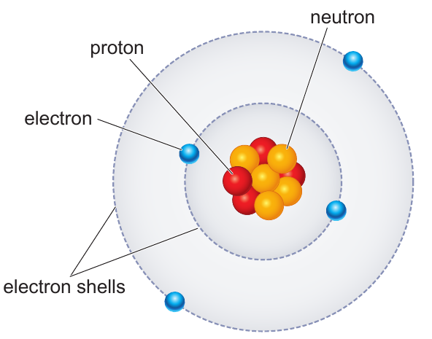
How to Read the periodic table
This is Beryllium
It’s atomic mass is 9 (this biggest number and atomic number is 4 (the smallest number).
To draw out the atom like below these numbers are Key
To know how many protons and electrons there are you look for the atomic number which in this case is 4. Picture below shows this.
Then to work how many neutrons you the atomic number away from the atomic mass which is 9-4= 5 so you now then have 5 neutrons
So the answer would be
Protons:4
Electrons:4
Neutrons:5

Slide 3
Atoms are made up of:
Protons – found in the nucleus
Neutrons – found in the nucleus
Electrons – found in shells around the outside of the atom
Notes:
Think pair share

Slide 4
An atom is made up of 3 types of subatomic particle:
Protons and neutrons are found in the nucleus
Electrons are found around the nucleus in electron shells
Atomic number = number of protons
Number of protons = number of electrons
Atomic mass = number of protons + number of neutrons

Slide 5
Bronze:
Deduce the number of subatomic particles in carbon, lead, mercury and radium.
Explain why all of these elements have no overall charge.
Silver:
Explain why a mercury atom does not have an overall charge. Justify whether this is true for all atoms.
Explain the difference between the atomic number and mass number for an element.
Gold:
Produce a set of instructions for somebody to calculate the number of protons, neutrons and electrons in an atom using the periodic table.
Justify why a cathode ray tube was able to separate out the subatomic particles of an atom.
Explain why the electron was deflected further than the proton

Slide 6
Progress Questions
Magnesium contains 12 electrons. It has an electron configuration of:
6.6
8.4
2.8.2
Use the electron configuration of magnesium to identify which group and period of the periodic table it is found in.
Explain what is meant by an isotope.

