Slide 3
Atomic Structure Learning Objective: To be able to describe the structure of an atom, and identify the number of protons, neutrons and electrons in atoms
Character Strength:
Last week: State the type of particles used to show the existence of electrons being in a cloud around the nucleus of an atom
Last term: Calculate the energy required to raise the temperature of 2.5kg of water by 25C, if the specific heat capacity of water is 4200kg/C
Last year: State the atomic model that we use today in Chemistry and Physics
Links to your future:
The basis of all matter
Keywords
Atomic Number
Relative Atomic Mass
Electron Configuration
We have learnt about the history of the atom
We are learning about Atomic structure
We will go on to learn about States of matter and interconversions

Slide 4
Fail Task
Draw and label an atom (5 labels) and fill in the information in the table.
Subatomic Particle | Mass | Charge | Location

Slide 5
Sail Task
Draw and label an atom (5 labels) and fill in the information in the table.
Subatomic Particle | Mass | Charge | Location

Slide 6
Atom facts
They have a radius of an atom is about 1 X 10⁻¹⁰ meters
In a 50p piece there are 77400000000000000000000 (20 “0”s) atoms
The radius of the nucleus of an atom is 1 X 10⁻¹⁴ meters
That is 1/10000 of the size of an atom – or your fist in the Royal Albert Hall

Slide 8
Complete the attached worksheet using the periodic table below

Slide 9
Element | Atomic number | Mass number | Number of protons | Number of neutrons | Number of electrons
Hydrogen | 1 | 1 | 1 | 0 | 1
Helium | 2 | 4 | 2 | 2 | 2
Lithium | 3 | 7 | 3 | 4 | 3
Beryllium | 4 | 9 | 4 | 5 | 4
Boron | 5 | 11 | 5 | 6 | 5
Carbon | 6 | 12 | 6 | 6 | 6
Nitrogen | 7 | 14 | 7 | 7 | 7
Oxygen | 8 | 16 | 8 | 8 | 8
Fluorine | 9 | 19 | 9 | 10 | 9
Neon | 10 | 20 | 10 | 10 | 10
Sodium | 11 | 23 | 11 | 12 | 11
Magnesium | 12 | 24 | 12 | 12 | 12
Aluminium | 13 | 27 | 13 | 14 | 13
Silicon | 14 | 28 | 14 | 14 | 14
Phosphorus | 15 | 31 | 15 | 16 | 15
Sulfur | 16 | 32 | 16 | 16 | 16
Chlorine | 17 | 35 | 17 | 18 | 17
Argon | 18 | 40 | 18 | 22 | 18
Potassium | 19 | 39 | 19 | 20 | 19
Calcium | 20 | 40 | 20 | 20 | 20

Slide 10
They go up in 1s.
Atomic number, number of protons and number of electrons.
Hydrogen – mass number is 1 which is the same as its atomic number.
Hydrogen.
Helium, carbon, nitrogen, oxygen, neon, magnesium, silicon, sulfur, calcium.
They increase by 8.
Yes.
a)sodium, b) fluorine, c) helium
Add the neutrons and protons together to work out the mass number.
Or match the number of electrons (or protons) to the atomic number.
a)chlorine b) sodium c) lithium
The number of electrons equals the number of protons (which is the same as the atomic number). Find the element with that atomic number.
a) 6 neutrons b) 7 neutrons c) 8 neutrons d) 10 neutrons e) 10 neutrons
Look at the number of electrons. The number of electrons equals the number of protons, then look for the elements with the same atomic number as the number of electrons. Then take the mass number and subtract the atomic number from it.

Slide 11
Electron Configuration
How many electrons are in each electron shell?
Shell 1 - 2
Shell 2 - 8
Shell 3 – 8
What resource can we use to check how many electrons are the outer shell of an atom?
We can use the periodic table – the group number tells you how many electrons are in the outer shell of each element. E.g. If in Group 1, it 1 electron in the outer shell, if in Group 7, it has 7.

Slide 12
1. helium | 2. carbon | 3. sulfur
4. magnesium | 5. aluminium | 6. argon

Slide 13
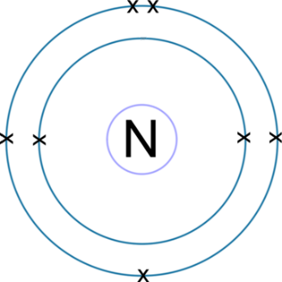
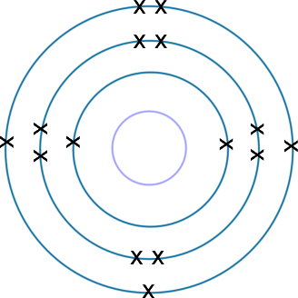
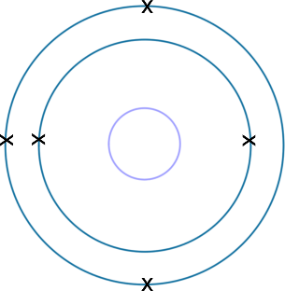
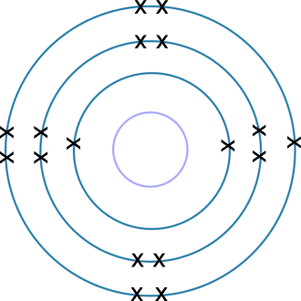
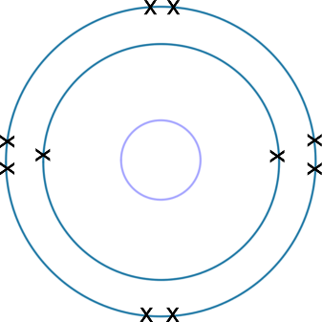
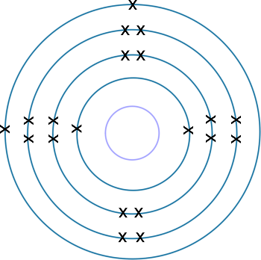
1. N nitrogen 2,5 2. P phosphorus 2,8,5 3. B boron 2,3
4. Cl chlorine 2,8,7 5. Ne neon 2,8 6. Ca calcium 2,8,8,2

Slide 14
Group 1 | Symbol | Atomic number | Electron configuration |  | Group 0 | Symbol | Atomic number | Electron configuration
lithium | Li | 3 | 2,1 |  | helium | He | 2 | 2
sodium | Na | 11 | 2,8,1 |  | neon | Ne | 10 | 2,8
potassium | K | 19 | 2,8,8,1 |  | argon | Ar | 18 | 2,8,8

Slide 15
As you go down the table the next element has 8 more electrons. Each outer shell has 1 electron.
As you go down the table the next element has 8 more electrons. Each outer shell is full.
As you go down the table the next element has 8 more electrons. Each outer shell has 2 electrons.

