Slide 1
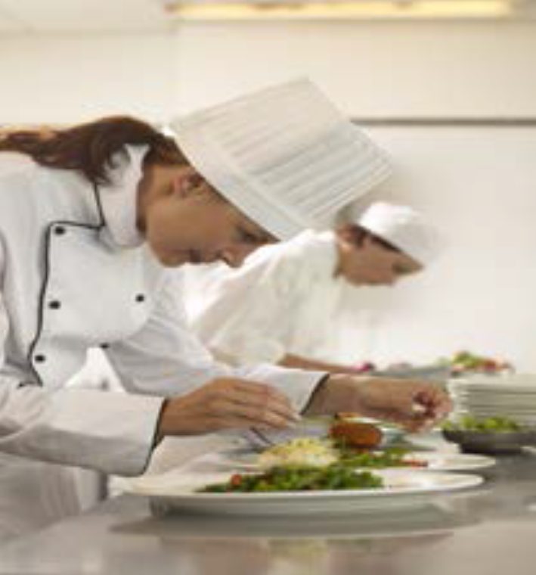
WJEC EDUQAS
LEVEL 1 / 2
Hospitality and Catering

Slide 2
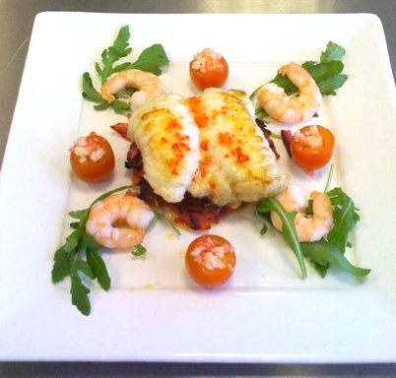
STUDENT INFORMATION
You will be given an assignment brief. You will be asked to complete several tasks.
You must complete each assessment criteria in order to pass. These are referred to AC’s in the tasks.
You have nine hours to complete he tasks.
TASKS
Propose four nutritional dishes for ………………………….
Plan for the production of two dishes that could be included on the menu.
Prepare, cook and present the two dishes that the apprentice will prepare and cook.
THE MARKS ARE BROKEN DOWN AS FOLLOWS:
If you are absent on any days then you will be expected to stay behind after school to catch up.
You are only allowed 9 hours in total to complete your work.
PASS
1
PASS
2
MERIT
DISTINCTION
It is important that you complete each of the AC’s in order to pass. The more detail and skills you include, the higher the grade.

Slide 3
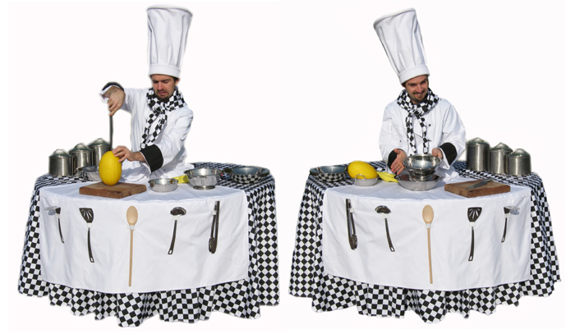
EduQas
Level 1 / 2
Hospitality and catering
Name:
Centre Name:
Centre Number:
Candidate Number:

Slide 4
THE BRIEF
Traditional British dishes made using local ingredients have become popular with chefs and customers due to the popularity of television shows such as the Great British Bake Off, Great British Menus and MasterChef. People also want to be more environmentally friendly by reducing food miles and food waste. "Waste Not, Want Not" is a new bistro due to open on the edge of a city centre. The bistro is located on the roof of a canal-side warehouse which also holds a number of other businesses including a local food market and an arts and craft centre which runs workshops for adults and children. The owners will also act as the catering manager and head chef. They have hired three catering assistants to work in the kitchen and they have plans to employ an apprentice. The owners are now finalising the menu. They want to showcase the food of their country and hope to serve nutritious, interesting dishes which contain locally sourced, seasonal ingredients. At the same time, they want to promote the idea of sustainable living to families with young children. The owners plan to grow herbs and salad ingredients on the roof and have 6 outdoor tables for service. There will be another 8 tables inside the bistro. The owners want to make sure that the dishes they serve are not only healthy, but that the establishment meets all legal and environmental requirements. You have been appointed as one of the catering assistants and your first responsibility is to plan some of the dishes for the bistro menu. The dishes can be starters, main courses or desserts, but must include local ingredients. The apprentice must be able to prepare and cook at least two of the dishes that will be included on the new menu. You therefore need to ensure the dishes you choose allow the apprentice to demonstrate three skills in preparation and three in cooking. To help the apprentice you also need to produce a plan that he/she can follow to cook the dishes. To make sure your plan works, you should cook the dishes using the plan.
Remember you have only 9 hours to complete the task.

Slide 5
TASKS
Time 3 hours.
Resources Access to class notes; access to ICT software: access to Internet to research possible dishes.
Supervision You will be supervised throughout. Collaboration Individual task .
Feedback You cannot be given feedback on the work you produce until it has been marked.
TASKS 1. Propose four nutritional dishes to meet the needs of the brief.
2. Plan for the production of two dishes that could be included on the menu.
3. Prepare, cook and present the two dishes that the apprentice will prepare and cook.
Time 2 hours.
Resources Access to class notes; access to ICT software: no access to Internet .
Supervision You will be supervised throughout. Collaboration Individual task.
Feedback You cannot be given feedback on the work you produce until it has been marked.
Time 4 hours.
Resources Access to class notes; access to plan produced for Task 1; access to materials and equipment required to prepare, cook and present planned dishes.
Supervision You will be supervised throughout.
Collaboration Individual task.
Feedback You cannot be given feedback on the work you produce until it has been marked.

Slide 6
Task 1
AC 1.1. Describe the functions of nutrients in the human body.
AC 1.2. Compare nutritional needs of specific groups.
AC1.3. Explain the characteristics of unsatisfactory nutritional intake.
AC 1.4. Explain how cooking methods impact on nutritional value
Functions of nutrients in the body
Who needs what for their body?
What happens if you don’t eat a balanced diet?
How does cooking affect food
TASK 1
How am I going to present this work?
What resources can I use?
AC1.1
Protein Fat Water
Carbohydrates
Vitamins Minerals
Dietary Fibre
AC1.2
Adult, child, pensioners
Special diets
Medical conditions
Activity levels
AC1.3
Characteristics
Visible non visible
Nutritional deficiencies
Nutritional excesses
AC1.4
Boiling, steaming, baking,
grilling, stir fry,
Roasting, poaching

Slide 7
TASK 1
AC 1.1 Describe the functions of nutrients in the body

Slide 8
TASK 1
AC 1.2 Compare nutritional needs of specific groups.

Slide 9
TASK 1
AC 1.3. Explain the characteristics of unsatisfactory nutritional intake.

Slide 10
TASK 1
AC 1.4 Explain how cooking methods impact on nutritional value of food.

Slide 11
TASK 1
Understand menu planning
EXPLAIN
AC2.1 Explain factors to consider when planning menus.
DESCRIBE
AC2.2Describe how dishes on the menu address environmental issues.
REMEMBER
AC2.3Remember you will need to explain how menu dishes meet customer needs
How are you going to present this work?
Paragraphs, chart, will you include images?
AC2.1
Time of year, seasonality, commodities available, skills of staff, equipment available, time, service, costs, client, size.
AC2.2
Preparation and cooking methods
Ingredients, packaging
Conservation of energy and water
Reduce re-use recycle, sustainability
AC2.3
Customer needs
Nutritional
Cost
Taste, smell, texture, colour

Slide 12
Task 1
AC2.1 Explain factors to consider when proposing dishes for a menu

Slide 13
Task 1
AC2.2 Explain how dishes on a menu address environmental issues.

Slide 14
Task 1
AC2.2 Explain how menu dishes meet customer needs.

Slide 15
Task 1
Possible dish | Colour, flavour texture | Nutrients included | Cooking methods and skills shown | How the dish meets the brief
Propose four possible dishes to suit the brief

Slide 16
Task 1
Possible dish | Colour, flavour texture | Nutrients included | Cooking methods and skills shown | How the dish meets the brief
Propose four possible dishes to suit the brief

Slide 17
Task 1
Dishes chosen with reasons

Slide 18
Task 2
Plan for the production of dishes on a menu
AC2.4
Plan
Your plan must be in sequence
You must include timing
Include: Mis en place, cooking, cooling, hot holding, completion and serving.
Think about presentation techniques
Include preparation and cooking of any accompaniments
Use as many skills as possible
Your plan should include enough detail for someone else to be able to make the dishes in exactly the same way that you will.

Slide 19
Task 2 Special points
You will need to show that you have a full understanding of the need for food safety and hygiene when planning your dishes.
Special points should include
Temperatures of storage and cooking
Personal hygiene
Core temperatures
Types of risk, food poisoning
Washing up regularly
Setting up to serve
You must include as many special points as possible

Slide 20
Task 2
Time | Process | Special points
AC2.4 Plan production of dishes for a menu

Slide 21
Task 2
Time | Process | Special points
AC2.4 Plan production of dishes for a menu

Slide 22
Task 2
Time | Process | Special points
AC2.4 Plan production of dishes for a menu

Slide 23
Task 2
Time | Process | Special points
AC2.4 Plan production of dishes for a menu

Slide 24
Task 2
Time | Process | Special points
AC2.4 Plan production of dishes for a menu

Slide 25
TASK 3 Photographs of final dishes made

Slide 26
TASK 3 Photographs of final dishes made

