Slide 1
$$\text{Perpendicular} \text{Lines}$$

Slide 2
Perpendicular Lines
Perpendicular lines meet at right angles
If you multiply gradients of perpendicular lines you will always get -1

Slide 3
Finding a Perpendicular Gradient
Find the numbers which are needed to make -1
3
x
-1/3
=
-1
Think about the Do it Now
How do reciprocals work?
7
x
-1/7
=
-1
-9
x
1/9
=
-1
-5
x
1/5
=
-1
-1/5
x
5
=
-1
-2/7
x
7/2
=
-1

Slide 4
y=3x-8
Gradient 1 x Gradient 2 = -1 for perpendicular lines
y=-1/3x+6
y=-1/3x+7
y=-1/3x-11
3 times -1/3 gives -1
So any line with a gradient of -1/3 will be perpendicular to y=3x-8

Slide 5
Calculate the gradient of a line perpendicular to the following lines
1) y= 2x-4
2) y= 0.5x +6
3) y= x -5
4) y= 4x -8
5) y= 1/4x +2
6) y= 0.25x -5
7) y= 5x +6
8) y= 8x -6
5 minutes
End
Hint: 1 divided by the number gives the reciprocal- remember a perpendicular line will have the opposite gradient

Slide 6
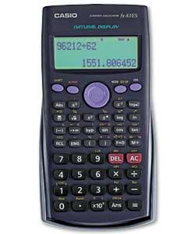
Calculating more complicated perpendicular gradients
How can we calculate a gradient for a line perpendicular to y=3/5 x+4?
What is 1 divided by 3/5?
Hint: 1 divided by the number gives the reciprocal- remember a perpendicular line will have the opposite gradient

Slide 7
Use the reciprocal button to find the following reciprocals
1) 4/9
2) 1.25
3) 1/3
4) 2/7
5) 5
6) 5.75
7) 1.75
8) 6/7
4 minutes
End

Slide 8
Finding the equation of a line
Find the equation of the line which is perpendicular y=2x + 8 at the point (1,10)
Gradient will be -0.5
Equation so far is y=-0.5x + c
We know it passes through (1,10) so put these values in
10=-0.5+ c
c must be 10.5
y=-0.5x + 10.5

Slide 9
Example 2
Find the equation of the line which is perpendicular y=5x + 8 at the point (5,33)
Gradient will be -1/5
Equation so far is y=-1/5x + c
We know it passes through (5,33) so put these values in
33=-1+ c
c must be 34
y=-2x + 34

Slide 10
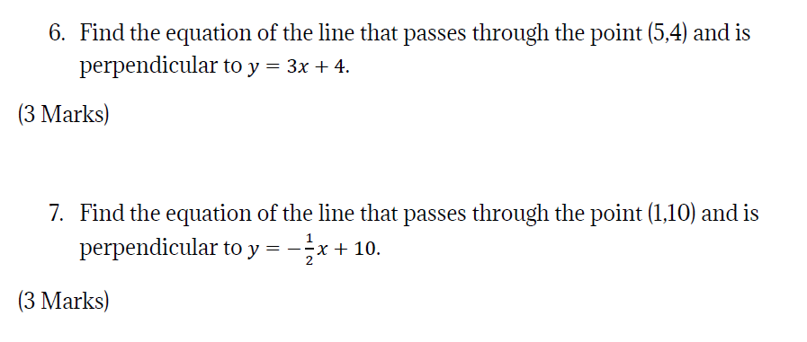

Slide 11
Plenary
Spot the mistakes:
Find the equation of the line which is perpendicular to
y = 2x + 3 and passes through the point (3, 9).
y = ½x + c
-1 ÷ 2 = ½
9 = ½(3) + c
3 = 1½ + c
4½ = c
y = ½x + 4½

Slide 12
I can work out intervals on a number line
Fluency

Slide 13
L/Q:
TIME
Power OF 3
← 5 Minute Timer →
Gradient, Intercept, Straight Line, Co-ordinates, Plot, Substitution, Parallel, Perpendicular, Reflection
Keywords
L.O To be able to simplifying a ratio

Slide 15
I can work out intervals on a number line
Fluency
Reasoning
Problem Solving

Slide 16
I can work out intervals on a number line
Fluency
Reasoning
Problem Solving

Slide 17
I can work out intervals on a number line
Fluency

Slide 18
I can work out intervals on a number line
Reasoning

Slide 19
I can work out intervals on a number line
Problem Solving

